Slide 1

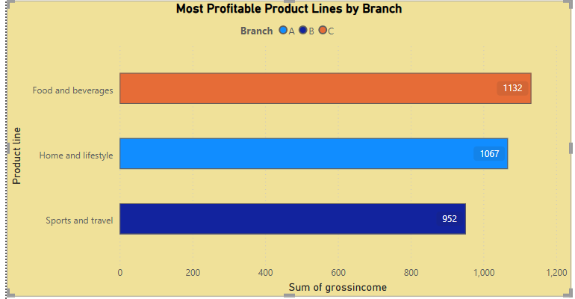
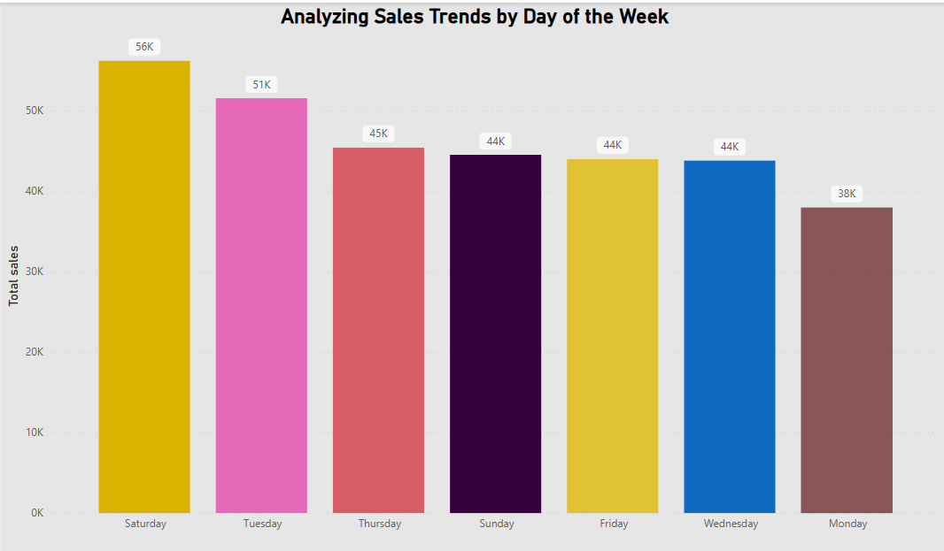
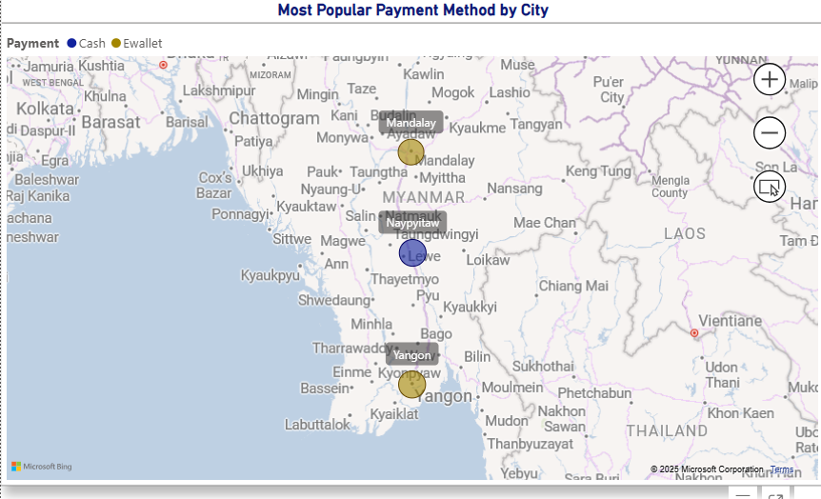
INTERNSHALA TRAINING
SQL PROJECT
Project Title:
Sales Performance Analysis of Walmart Stores Using Advanced MySQL Techniques
VIDEO LINK:- https://drive.google.com/file/d/1OLE_gU5mJjzBzpq-yAiPkkcMA2UQg8CJ/view?usp=drive_link

Slide 2

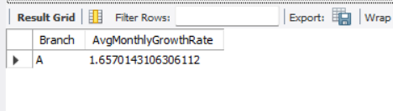
TASK 1
Identifying the Top Branch by Sales Growth Rate
Identifying the top branch by sales growth rate means finding the branch with the highest percentage increase in sales over a period. This helps highlight which branch is expanding its sales performance the fastest.
OUTPUT:-
QUERY:-
WITH MonthlySales AS
(SELECT
Branch,
DATE_FORMAT(STR_TO_DATE(Date, '%d-%m-%Y'), '%Y-%m') AS YearMonth, SUM(Total) AS TotalSales
FROM walmartsales
GROUP BY Branch, YearMonth),
MonthlyGrowth AS
(SELECT
Branch,
YearMonth,
TotalSales,
LAG(TotalSales) OVER (PARTITION BY Branch ORDER BY YearMonth) AS PrevMonthSales
FROM MonthlySales)
SELECT
Branch,
AVG(((TotalSales - PrevMonthSales) / PrevMonthSales) * 100) AS AvgMonthlyGrowthRate
FROM MonthlyGrowth
WHERE PrevMonthSales IS NOT NULL
GROUP BY Branch
ORDER BY AvgMonthlyGrowthRate DESC
limit 1;

Slide 3
TASK 2
Finding the Most Profitable Product Line for Each Branch
Finding the most profitable product line for each branch involves determining which product line generates the highest profit at each location. This helps optimize inventory and marketing strategies per branch.
QUERY:-
WITH profitline_of_all_branches as
(select
Branch,
`Product line`,
Sum(Total),Sum(cogs),
Sum(Total)-Sum(cogs) as grossincome from walmartsales
Group by Branch ,`Product line`)
select
Branch,
`Product line`,
grossincome
from profitline_of_all_branches
where (Branch,grossincome) In(select Branch ,Max(grossincome) from profitline_of_all_branches
group by Branch)
order by Branch;

Slide 4
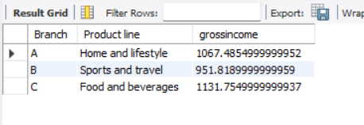
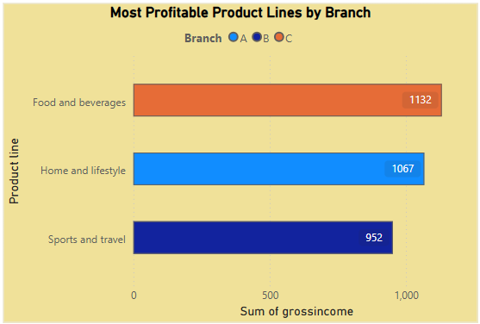
OUTPUT:-
VISUAL:-

Slide 5
TASK 3
Analyzing Customer Segmentation Based on Spending
Analyzing customer segmentation based on spending means looking at how much different groups of customers spend and grouping them accordingly. This helps businesses understand who their big spenders are and how to better serve each group.
QUERY:-
select *from walmartsales;
with avgspendcus as
(select
`Customer ID`,
Avg(Total) as avgspend
from walmartsales
group by `Customer ID`)
SELECT
`Customer ID`,
avgspend as averagespending,
CASE
WHEN avgspend between 260 AND 300 THEN 'LOW’
WHEN avgspend between 301 AND 350 THEN 'MEDIUM'
ELSE 'HIGH'
End as `category wise spending`
from avgspendcus
order by avgspend desc;

Slide 6
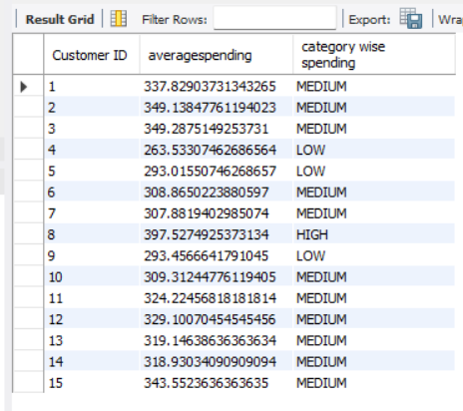
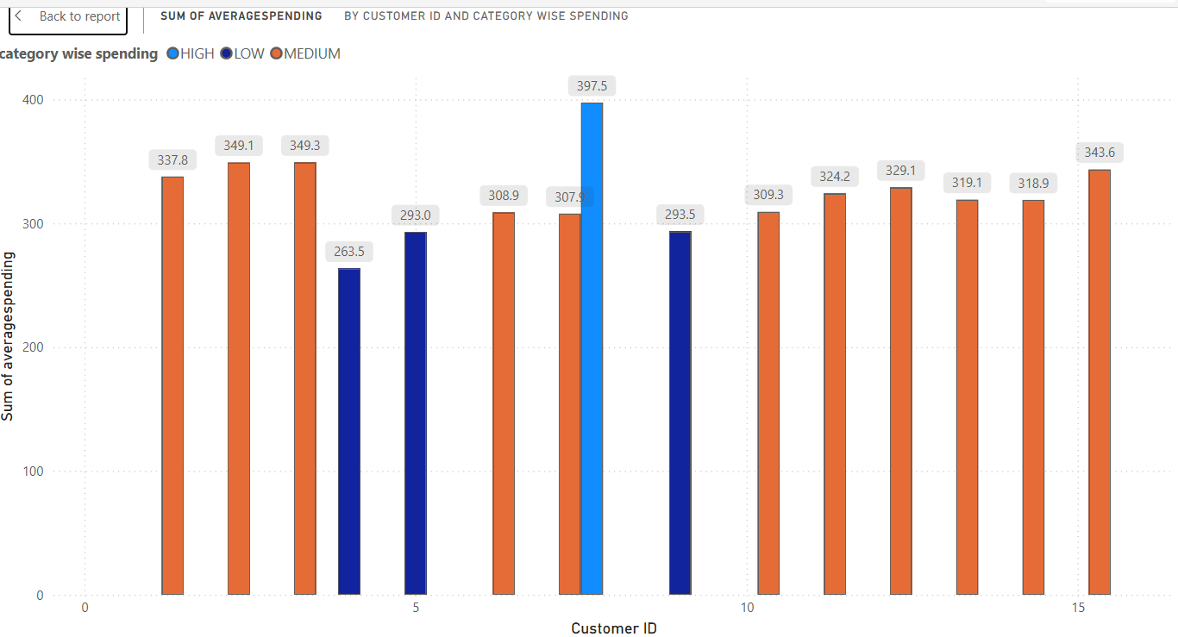
OUTPUT:-
VISUAL:-

Slide 7
TASK 4
Detecting Anomalies in Sales Transactions
Detecting anomalies in sales transactions means spotting unusual or unexpected patterns, like sudden spikes or drops in sales. It helps businesses catch errors, fraud, or unusual customer behavior early.
QUERY:-
WITH ProductLineAverage AS
(SELECT `Product line`, AVG(Total) AS avg_sales FROM walmartsales
GROUP BY `Product line`)
SELECT
w.`Customer ID`,
w.`Product line`,
w.Total AS transaction_sales,
pl.avg_sales,
ABS(w.Total - pl.avg_sales) AS difference_from_avg,
CASE WHEN ABS(w.Total - pl.avg_sales) > pl.avg_sales * 1.5 THEN 'Anomaly' ELSE 'Normal'
END AS transaction_status
FROM walmartsales wJOIN ProductLineAverage pl
ON w.`Product line` = pl.`Product line`
ORDER BY transaction_status DESC, transaction_sales DESC;

Slide 8
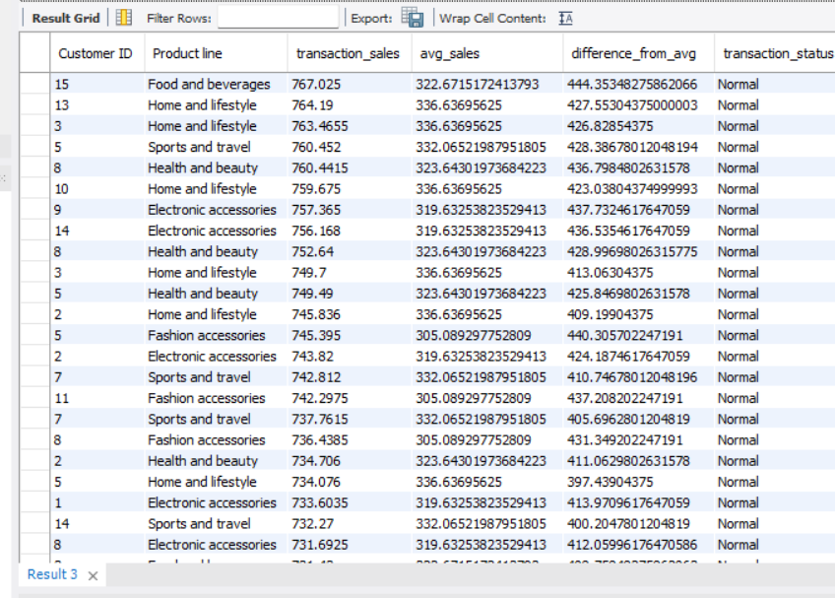
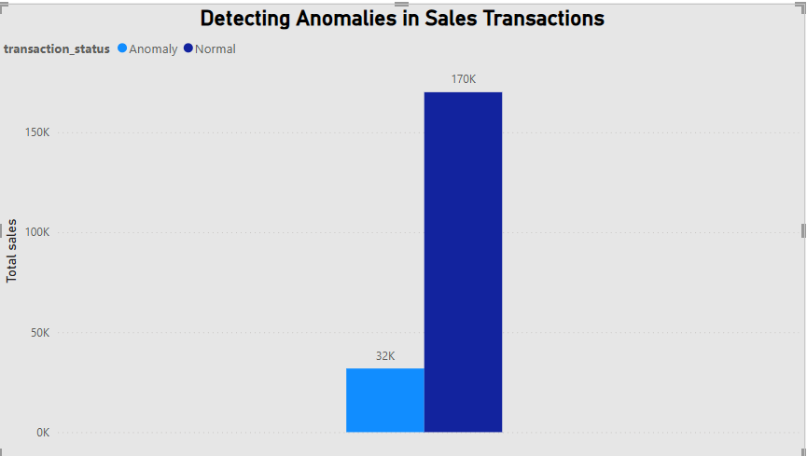
OUTPUT:-
VISUAL:-

Slide 9
TASK 5
Most Popular Payment Method by City
This means figuring out which payment option (like cash, card, or e-wallet) customers use the most in each city. It helps businesses cater to local preferences.
QUERY:-
WITH PaymentMethodCount AS
(SELECT City,
Payment,
COUNT(*) AS PaymentCount
FROM walmartsales
GROUP BY City, Payment)
SELECT City,
Payment
FROM PaymentMethodCount
WHERE (City, PaymentCount) IN (SELECT City, MAX(PaymentCount) AS MaxCount FROM PaymentMethodCount
GROUP BY City)ORDER BY City;
OR
Select City,
Payment,
Count(*) as count
from walmartsales
Group by Payment,City
order by count desc
limit 3;

Slide 10
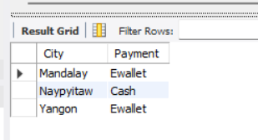
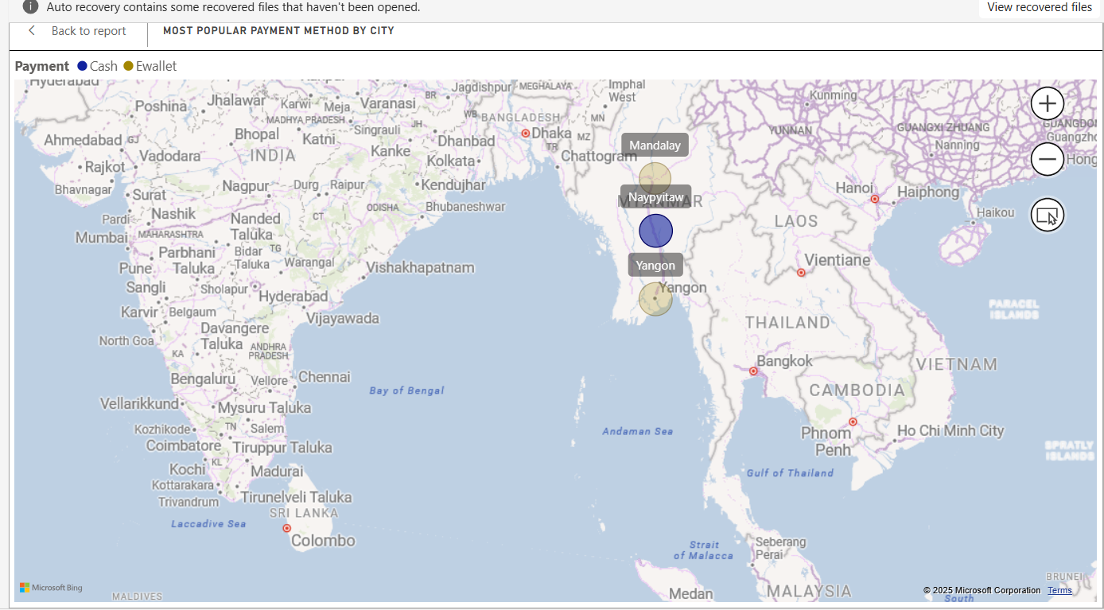
OUTPUT:-
VISUAL:-

Slide 11
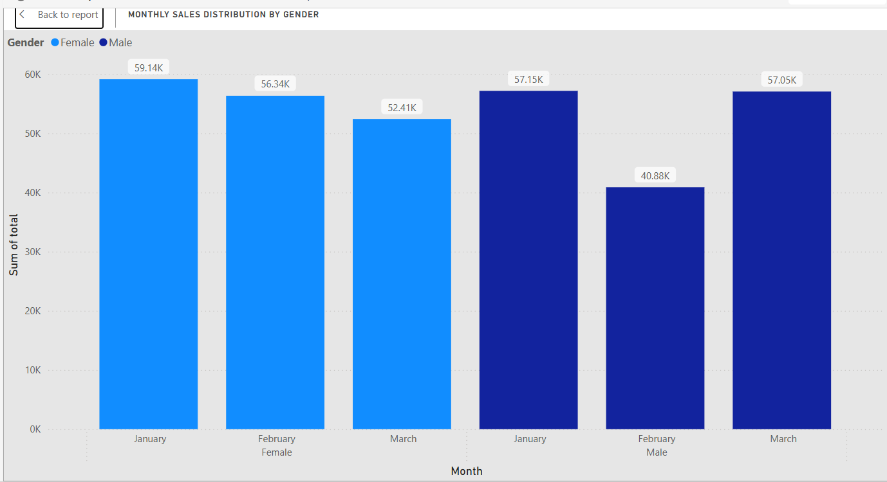
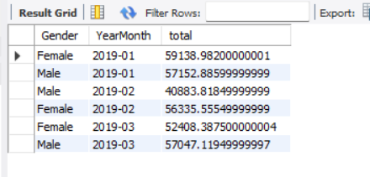
TASK 6
Monthly Sales Distribution by Gender
This looks at how sales vary each month between male and female customers. It gives insights into gender-based buying patterns over time.
QUERY:-
select *from walmartsales;
select Gender,
DATE_FORMAT(STR_TO_DATE(Date, '%d-%m-%Y'), '%Y-%m') AS YearMonth, SUM(Total) as total
from walmartsales
group by Gender,YearMonth
order by YearMonth asc;
VISUAL:-
OUTPUT:-

Slide 12
TASK 7
Best Product Line by Customer Type
QUERY:-
This means finding out which product category is most preferred by different types of customers, like members vs. new buyers. It helps in offering more personalized product suggestions.
SELECT `Customer Type`,
`Product line`,
SUM(Total) AS total
FROM walmartsales
GROUP BY `Customer Type`,`Product line`
HAVING SUM(Total)=(SELECT MAX(total_sales)
FROM
(SELECT `Customer Type`,`Product line`,
SUM(Total) AS total_sales
FROM walmartsales
GROUP BY `Customer Type`,`Product line`) AS max_sales_per_product
WHERE max_sales_per_product.`Customer Type` = walmartsales.`Customer Type`)
ORDER BY `Customer Type`;
OR
Select `Customer Type` ,
`Product line`,
SUM(Total) as total
from walmartsales
group by `Customer Type`,`Product line`
order by total desc
limit 2;

Slide 13
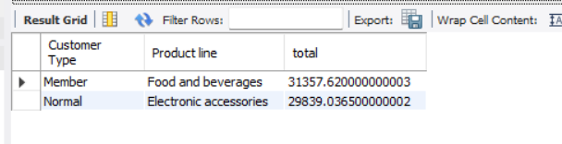
OUTPUT:-

Slide 14
TASK 8
Identifying Repeat Customers
This involves spotting customers who come back and shop more than once. It's useful for loyalty programs and retention strategies.
QUERY:-
WITH CustomerPurchases AS
(SELECT `Customer ID`,
STR_TO_DATE(`Date`, '%d-%m-%Y') AS PurchaseDate,
`Invoice ID`,
`Product line`,
ROW_NUMBER() OVER (PARTITION BY `Customer ID` ORDER BY STR_TO_DATE(`Date`, '%d-%m-%Y')) AS PurchaseSeq FROM walmartsales)
SELECT a.`Customer ID`,
DATE_FORMAT(a.PurchaseDate, '%d-%m-%Y') AS FirstPurchaseDate,
DATE_FORMAT(b.PurchaseDate, '%d-%m-%Y') AS SecondPurchaseDate,
DATEDIFF(b.PurchaseDate, a.PurchaseDate) AS DaysBetweenPurchases,
a.`Product line` AS FirstPurchaseCategory,
b.`Product line` AS SecondPurchaseCategory,
a.`Invoice ID` AS FirstInvoiceID,
b.`Invoice ID` AS SecondInvoiceID
FROM CustomerPurchases a
JOIN CustomerPurchases b
ON a.`Customer ID` = b.`Customer ID` AND a.PurchaseSeq = b.PurchaseSeq – 1
WHERE DATEDIFF(b.PurchaseDate, a.PurchaseDate) <= 30
ORDER BY a.`Customer ID`, a.PurchaseDate;

Slide 15
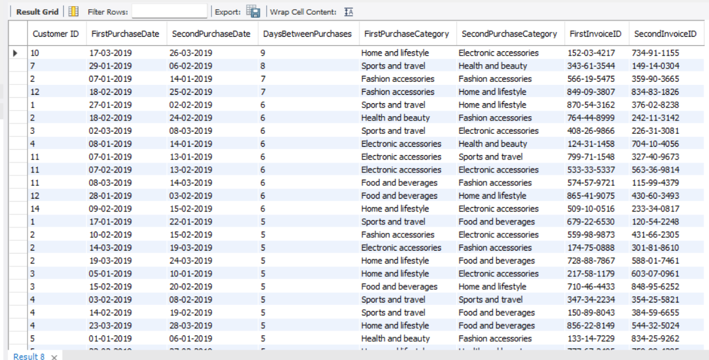
OUTPUT:-

Slide 16
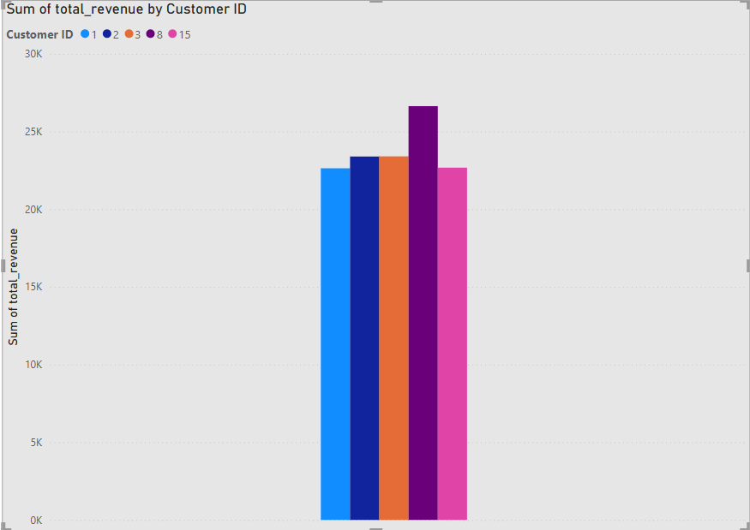
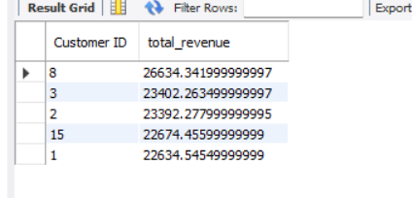
TASK 9
Finding Top 5 Customers by Sales Volume
Is about ranking the five customers who spent the most. Knowing them helps businesses recognize and reward their highest-value buyers.
QUERY:-
VISUAL:-
SELECT `Customer ID`,
Sum(Total) as total_revenue
from walmartsales
group by `Customer ID`
Order by total_revenue desc
limit 5;
OUTPUT

Slide 17
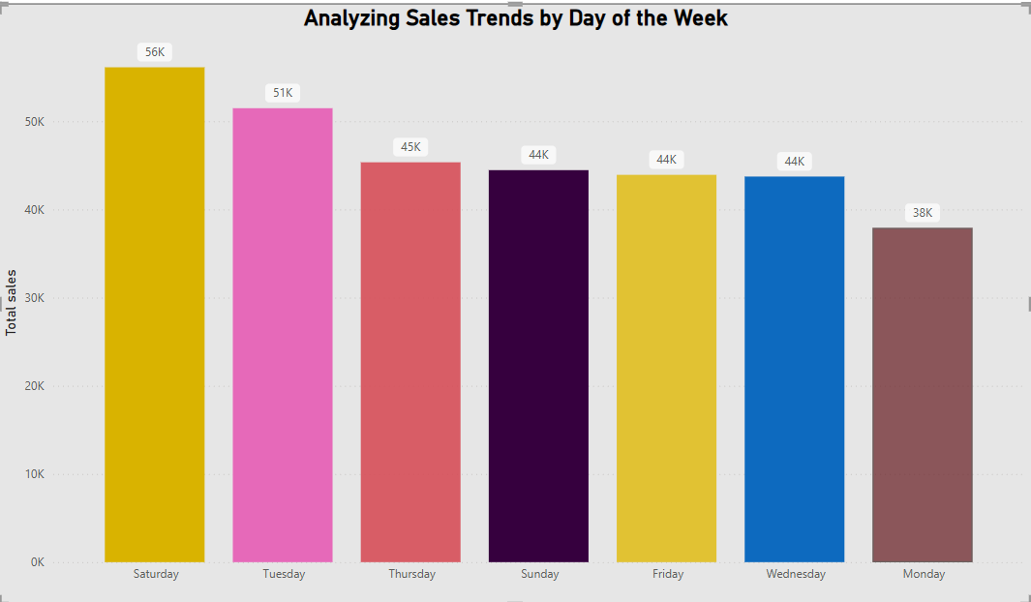
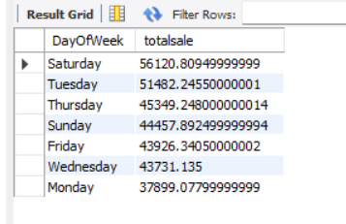
TASK 10
Analyzing Sales Trends by Day of the WeeK
This means checking which days have higher or lower sales. It helps with planning promotions and managing staff effectively.
QUERY:-
select
DAYNAME(STR_TO_DATE(`Date`, '%d-%m-%Y')) AS DayOfWeek,
Sum(Total) as totalsale
from walmartsales
group by DayOfWeek
order by totalsale desc;
VISUAL:-
OUTPUT

Slide 18
ANALYSIS
Promote top product lines per branch:
Branch B: Boost Home & Lifestyle with seasonal campaigns.
Branch C: Focus on Food & Beverages with meal deals and loyalty offers.
Branch A: Leverage Sports & Travel with event-based promos.
Optimize inventory for high-profit categories and cut low-performing stock
As we seen in Task 3 ,there is only one premium spender and majority of the peoples were fall on average as well as low spenders are low
*provide the Loyality rewards to the High spenders as well as Average spenders with personalized rewards to the repeat purchases,mainly focus on high sales customers
As we seen the analysis in Task 6, January: Female sales (59.14K) slightly higher than male (57.15K) — both genders show strong engagement.and February: Significant drop in male sales (40.88K) compared to females (56.34K).
March: Sales are balanced again, with males (57.05K) slightly ahead of females (52.41K).
Target February Male Customers: Launch special February promotions or campaigns aimed at male customers to prevent future dips.
In Task 10,
Peak Sales Days:
Saturday (56K) and Tuesday (51K) show the highest total sales.
Moderate Days:
Sales remain steady around 44–45K on Thursday, Sunday, Friday, and Wednesday.
Lowest Sales:
Monday records the least sales at 38K, showing a clear drop in engagement.
Boost Low-Sale Days:
Introduce Monday-specific promotions or limited-time offers to drive traffic.
Maximize High-Sale Days:
Allocate more staff and inventory on Saturdays and Tuesdays to handle peak demand

Slide 19
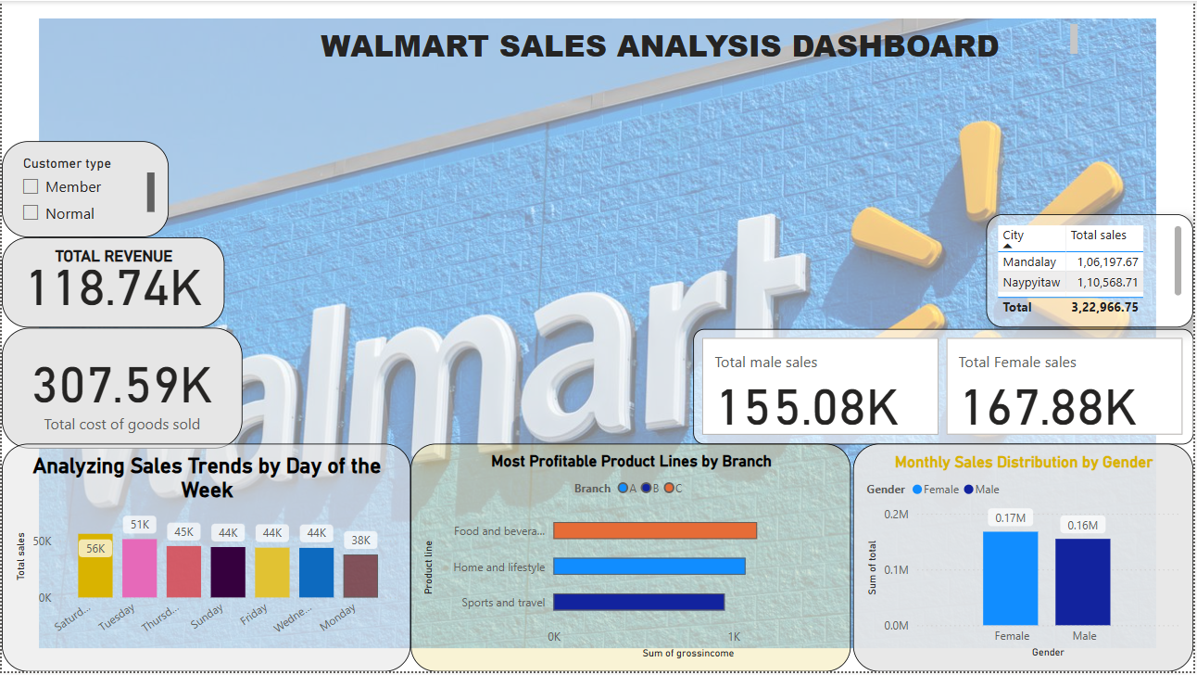

Slide 20


